Slide 1

Ahsanullah University of Science and Technology
Dept. of Computer Science and Engineering
Information System Design and Software Engineering Lab
(CSE 3224)
Hospital Management System
(Use Case And Class Diagram)
Submitted By :-
Shadman Sakib (16.01.04.092)
A.K.M. Sadman Ali (16.01.04.093)
Tasmia Tuj Juha (16.01.04.095)
Mehedi Hasan Abir (16.01.04.102)

Slide 2
Project Motivation
Unfavorable condition of existing systems
Making use of internet availability and high usage
Time saving

Slide 3
Primary Actors
“Actors that stimulate the system and initiate events”
Primary actors are:
Visitor
Administrator
Patient
Doctor

Slide 4
Secondary Actors
“Actors that receive stimuli from the system”
Secondary actors are:
Payment System
Cashier
Lab Employee

Slide 5
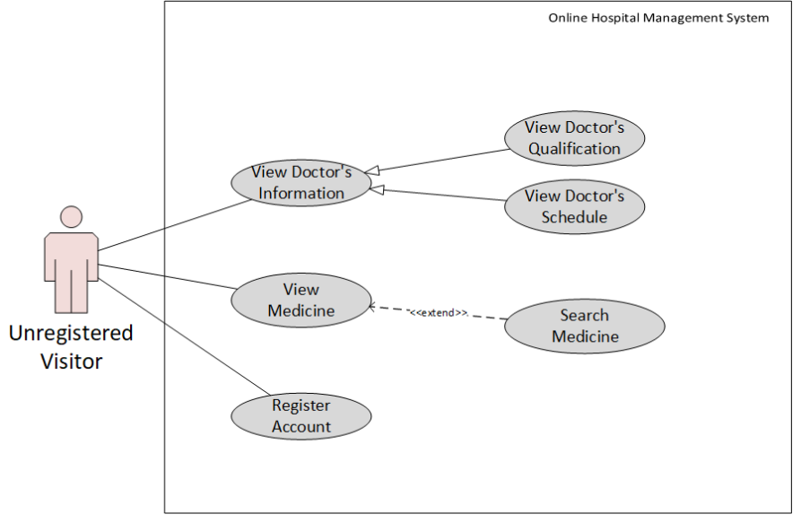
Use Case Diagram of Visitor

Slide 6
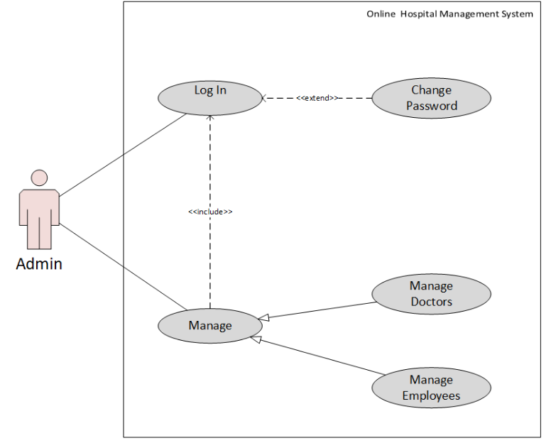
Use Case Diagram of Administrator

Slide 7
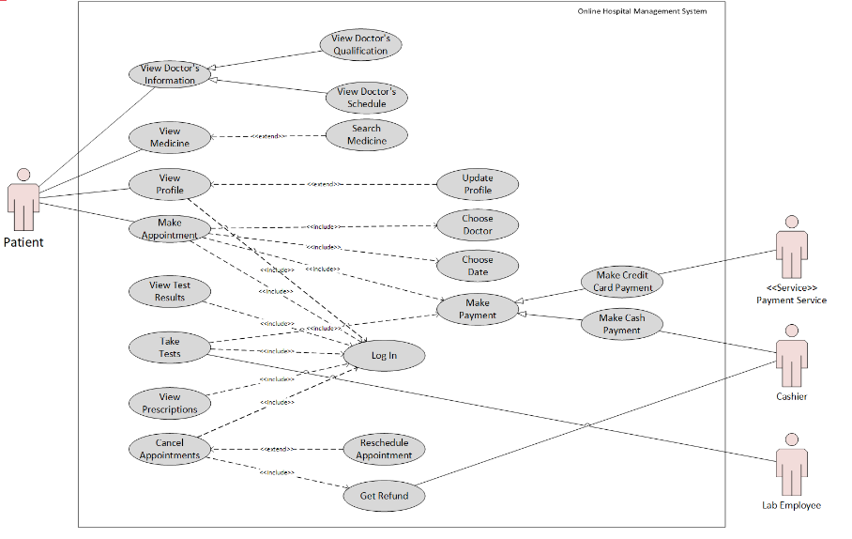
Use Case Diagram of Patient

Slide 8
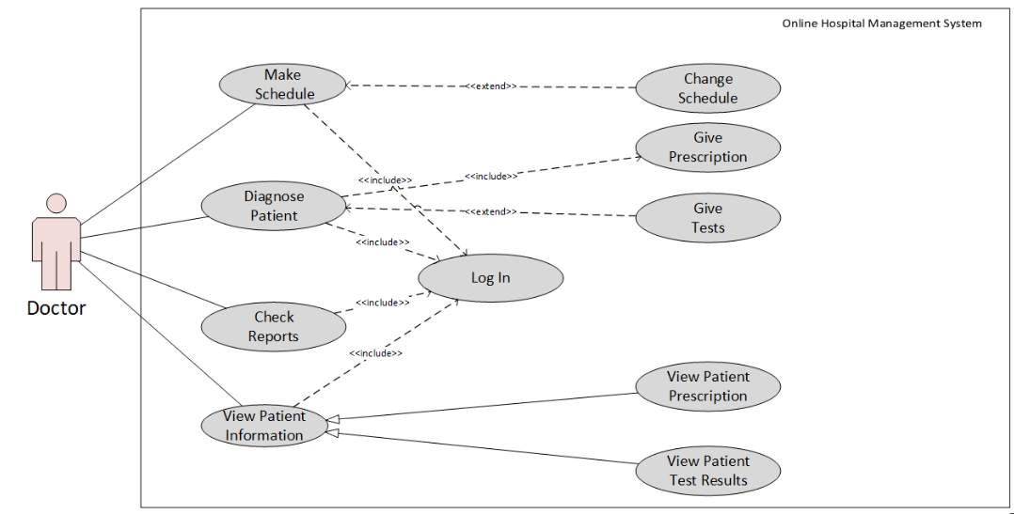
Use Case Diagram of Doctor

Slide 9
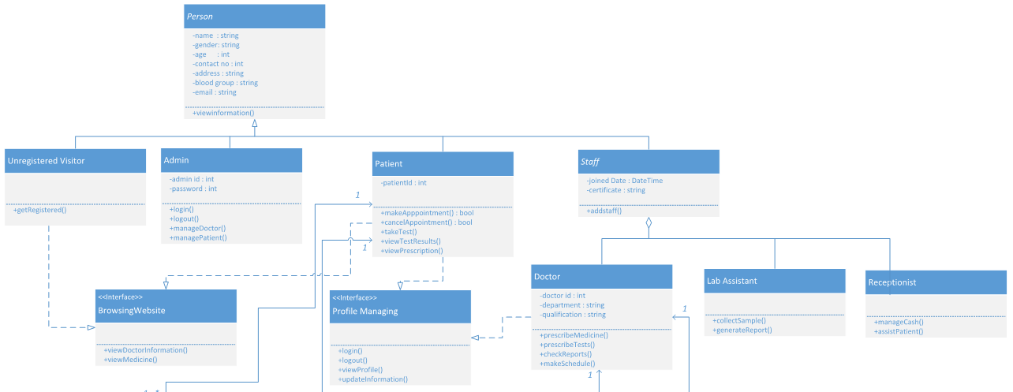
Class Diagram

Slide 10
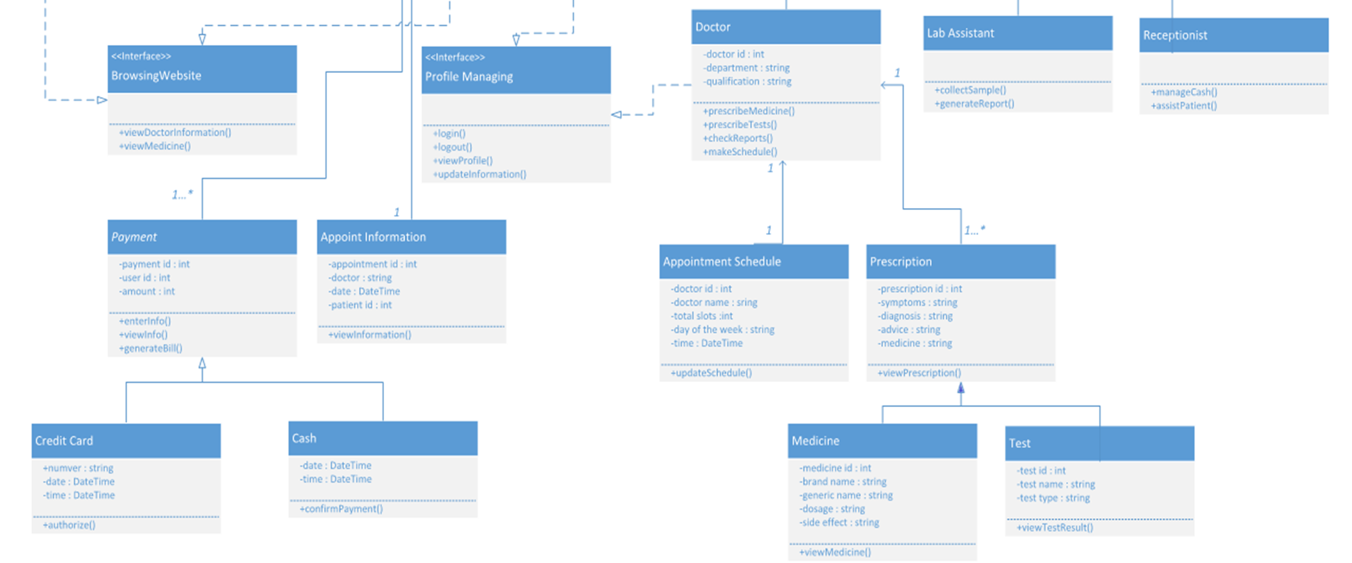
Class Diagram (Continued)

Slide 11
Conclusion
The use case and class diagrams we created helped us to provide a clear view of our project.
Specifically, the class diagram with classes and relations among them helps to get a clear object-oriented view of the project. Hence, creating these diagrams certainly boosted our progress.

Slide 12
THANK YOU! Any questions?

